Slide 1

Project – Cardiovascular risk prediction
Name – Deepak Pal
Email – deepak.pal18x@gmail.com

Slide 2
On healthcare routine examinations, it is consistently observed that heart diseases have attained a distressingly high prevalence, a trend attributed to a multitude of factors such as lifestyle choices, occupational stress, sedentary habits, and other contributing factors. Within the scope of this endeavor, we are dedicated to the development of a predictive model for estimating the 10-year risk of Coronary Heart Disease (CHD). To facilitate this predictive task, we are furnished with a comprehensive set of variables, each of which exerts a discernible influence on the likelihood of heart-related afflictions. These variables encompass a wide range of characteristics, encompassing demographic particulars, historical health records, and prevailing medical conditions. The dataset employed for this analysis originates from an ongoing cardiovascular study encompassing residents of the town of Framingham, Massachusetts. The primary objective is the classification of patients based on their likelihood of encountering coronary heart disease within the next decade. This dataset encompasses a substantial volume of data, comprising over 4,000 individual records and encapsulating 15 distinct attributes. These attributes encompass a spectrum of potential risk factors, encompassing those pertaining to demographic attributes, behavioral patterns, and medical history. The comprehensive nature of these variables equips us with valuable insights to construct an accurate and reliable predictive model for CHD risk assessment.
Problem Statement -
Our goal is to classify patients based on their likelihood of developing CHD in the next decade. By leveraging this dataset, we aim to build an accurate predictive model, taking into account various risk factors that influence CHD.

Slide 3
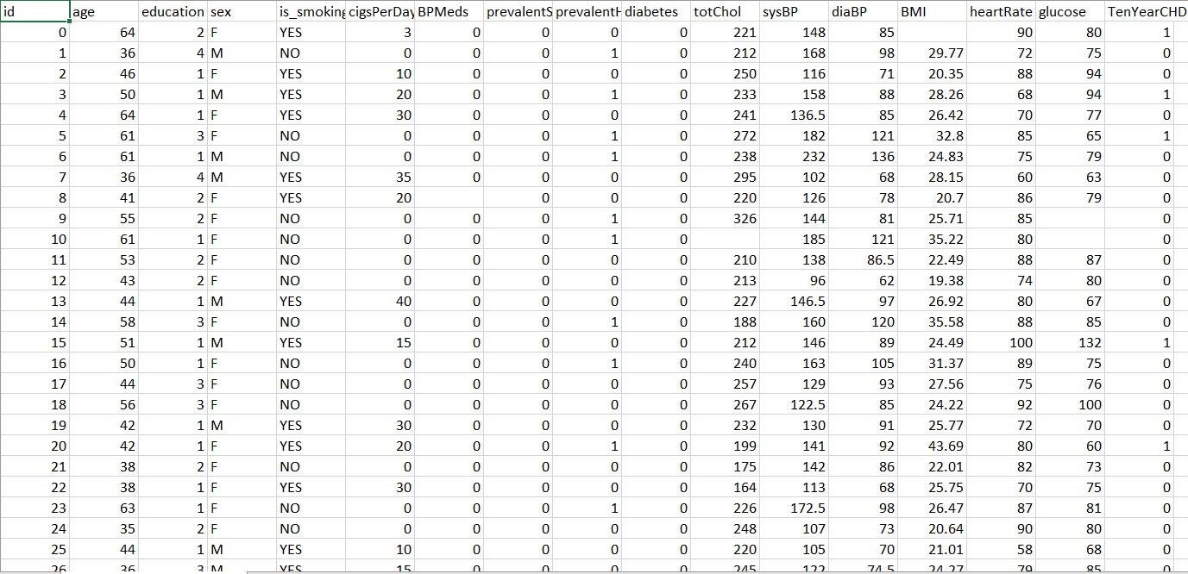
Data Structure -
No_of_columns – 17
No_of_Rows –3390
Target column – TenYearCHD
Problem - Classification

Slide 4
Exploratory Data Analysis (EDA) -
Shape - (3390, 17 )
Attributes - 'BMI', 'education','totChol ','cigsPerDay', 'BPMeds', 'heartRate’ and 'glucose' have small fraction of missing data.
We used mode for missing value treatment for 'BMI’ and 'BPMeds’ columns as they were discrete value columns.
We used median for missing value treatment for 'education','totChol ','cigsPerDay', 'heartRate’ and 'glucose’ columns as they were continuous and outlier affected columns.
Attributes - 'cigsPerDay', 'totChol', 'sysBP', 'diaBP', 'BMI', 'heartRate’ and 'glucose’ have small fraction of outliers which were treated using IQR method.
Exploratory data analysis provided valuable insights into the dataset. Visualizations such as histograms, scatter plots, and correlation matrices revealed patterns and correlations among variables, guiding our model development process.

Slide 5
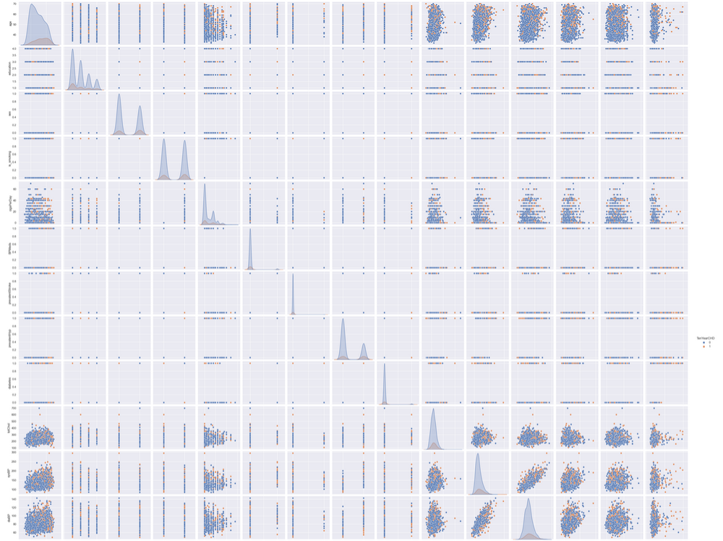
Pair plot –
To visualize relationship of features with one and another.

Slide 6
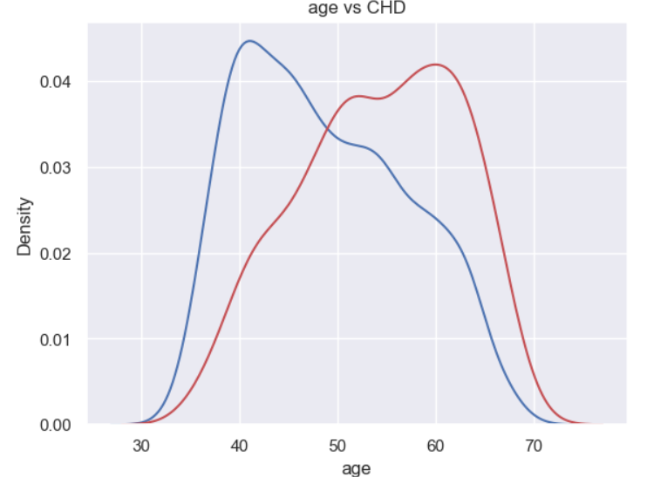
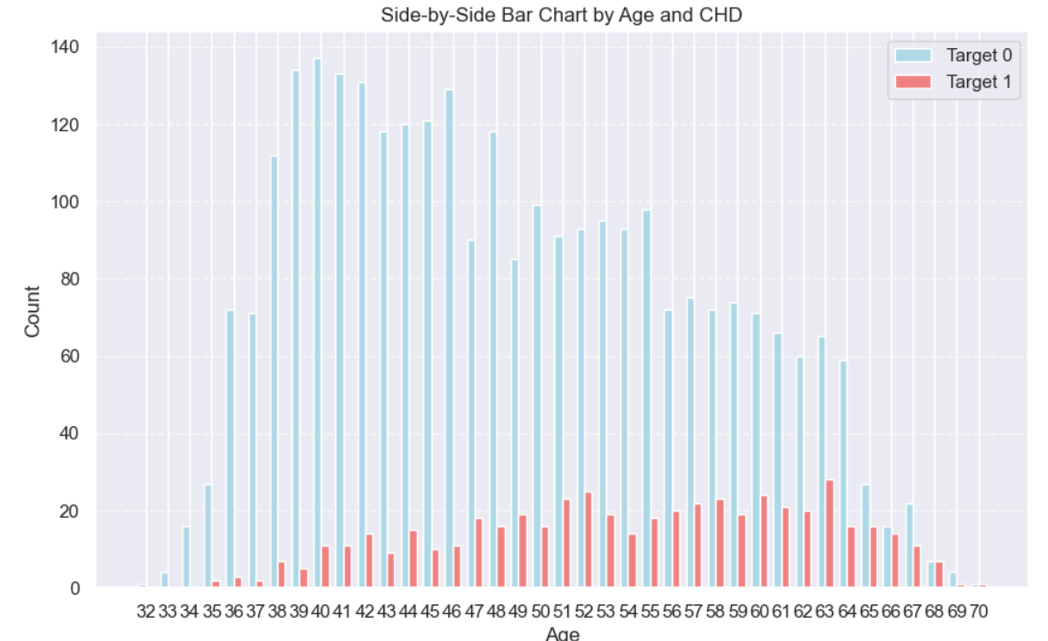
Insights –
key insights here is if 'age' is exceeding 43 years which is 25 percentile of the population, from all record of CHD in 10 years(511) around 456 (89%) falls under this.
Which we can clearly see in the distribution , where after 42 - 43 years of age we see gradual increase of CHD risk.

Slide 7
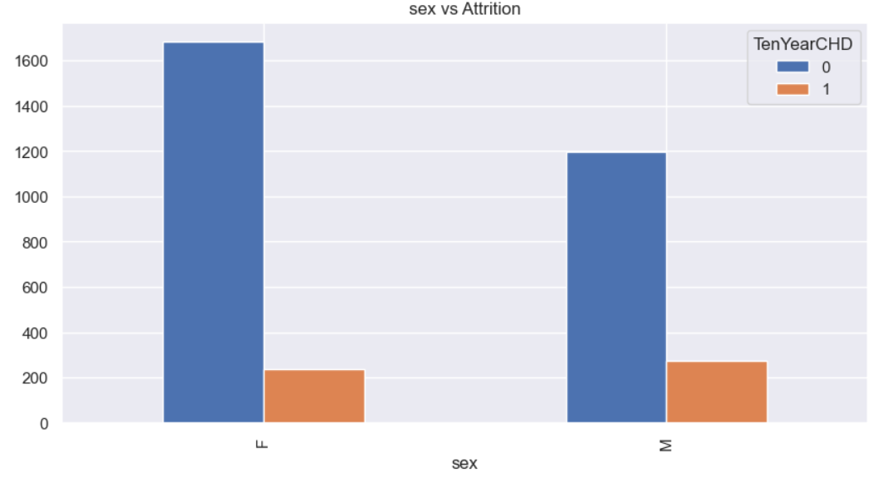
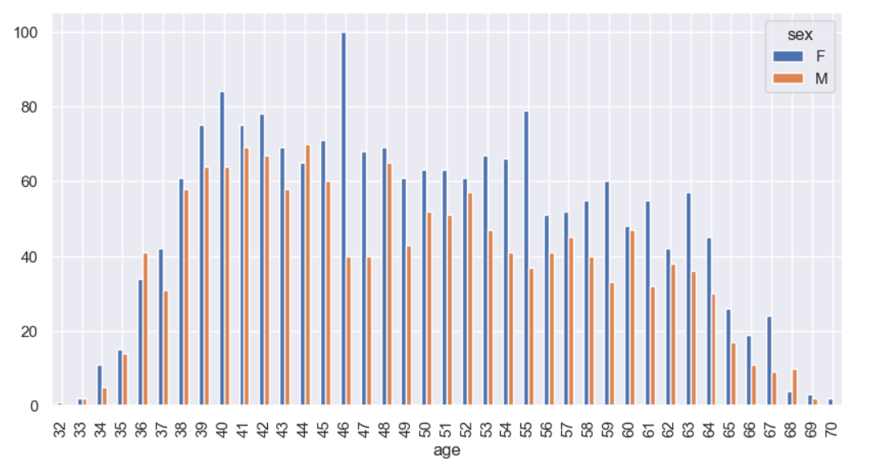
Insights -
Here we are analyzing whether sex is playing any role in CHD risk. There is no distinguishable pattern or insights that conclusively prove that either sex has any potential of having higher chance of CHD risk in 10 years.

Slide 8
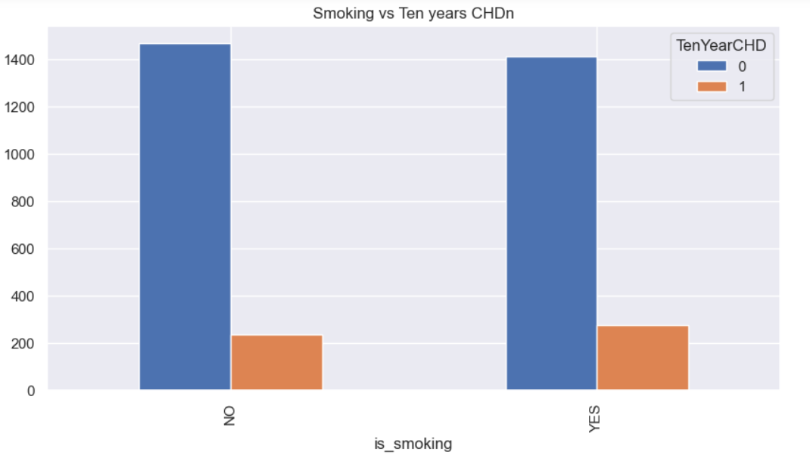
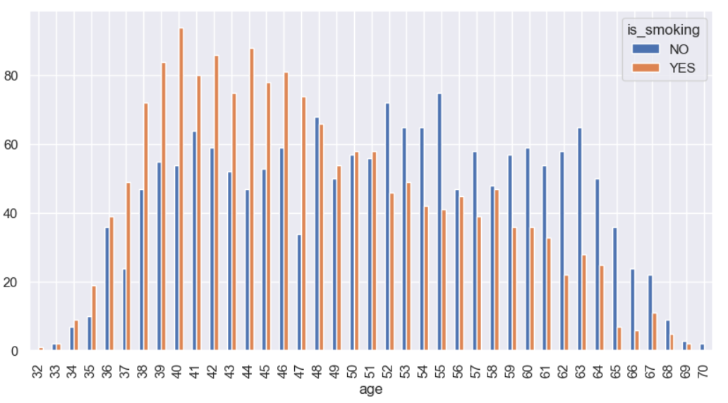
Insights –
On analyzing graphs of is_smoking attribute w.r.t to TenYearCHD we find no conclusively prove that it is directly affecting the risk factor ,but we will check other analysis too.

Slide 9
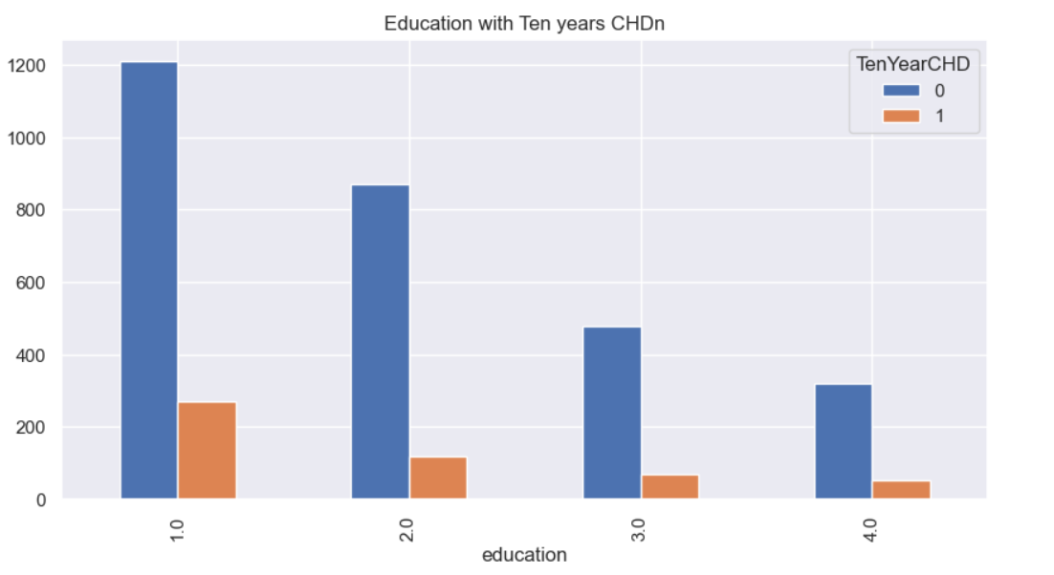
Insights –
Education w.r.t TenyearCHD

Slide 10
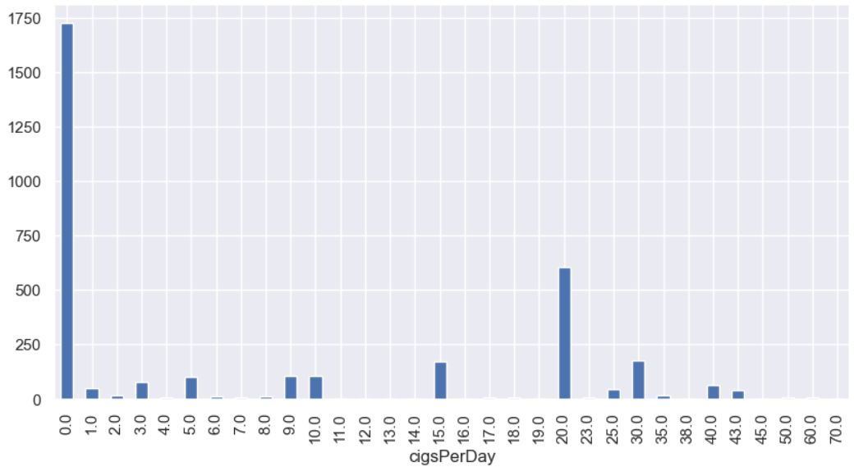
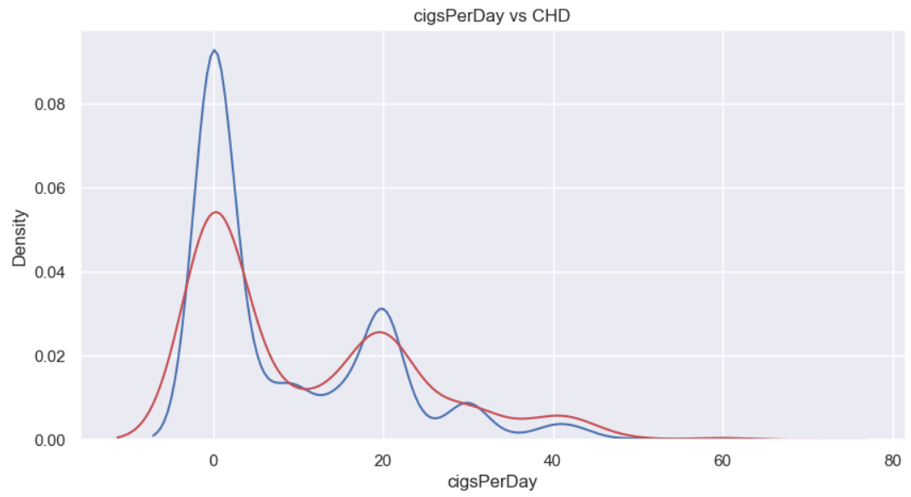
Insights –
By looking in the graph we can not deduce any noticeable pattern in cigsperday that indicated any conclusive evidence on direct relation in risk enhancement of CHD, but we will also check other analysis.

Slide 11
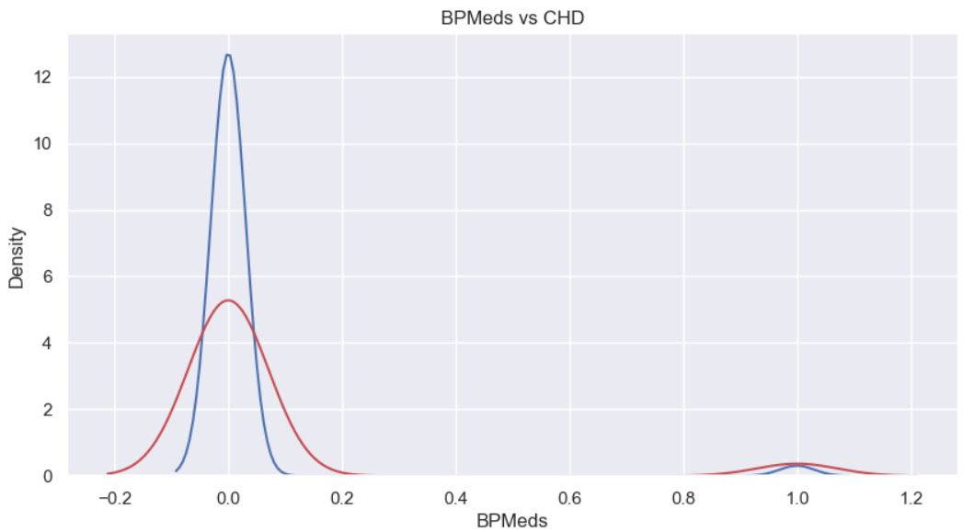
Insights –
Key insights that we got here is out of all records 82% or 2812 individuals which are classified as 0 CHD , are when the person is not taking BPMeds.
Indicating people with no medical history of bp have 82% chance of not being at risk of CHD.

Slide 12
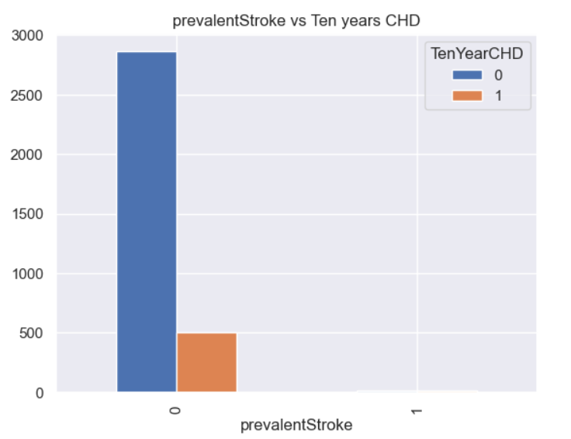
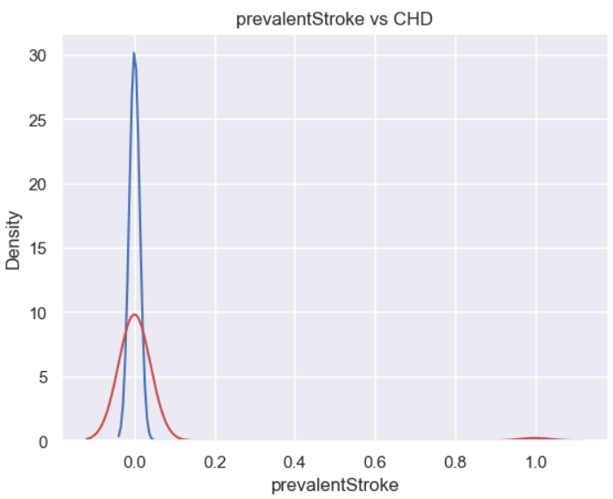
Insights –
By analyzing data here we found that out of all records 84% or 2867 individuals which are classified as 0 for CHD risk, are when the person didn't had prevalentStroke history .

Slide 13
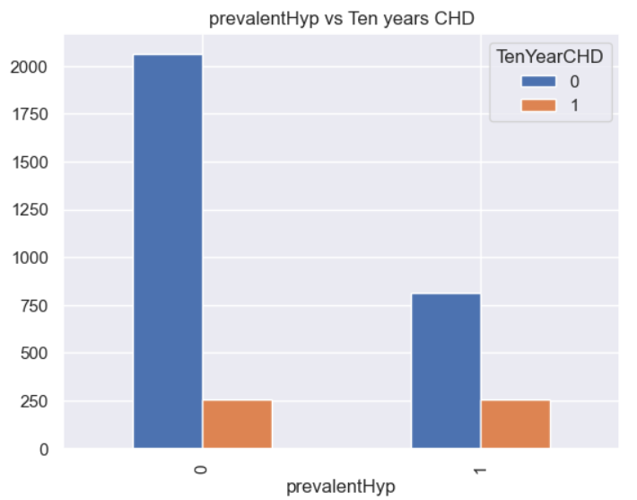
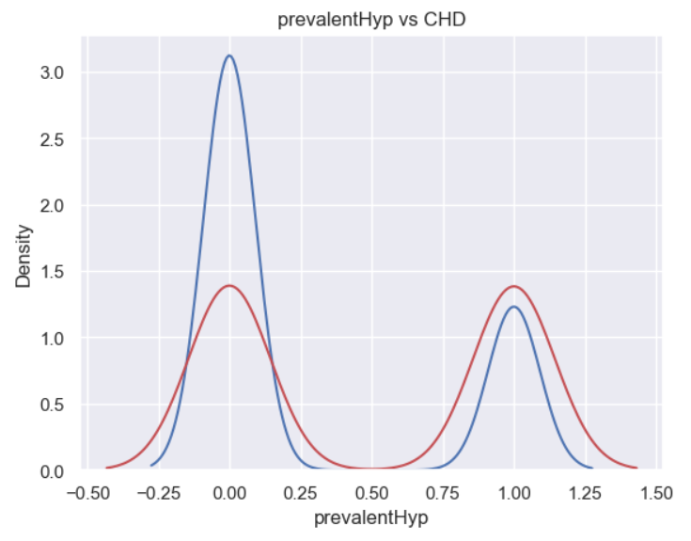
Insights –
By analysis of the attribute prevalentHyp , we found out of 3390 records 60% show no risk of CHD, if not having prevalentHyp history.

Slide 14
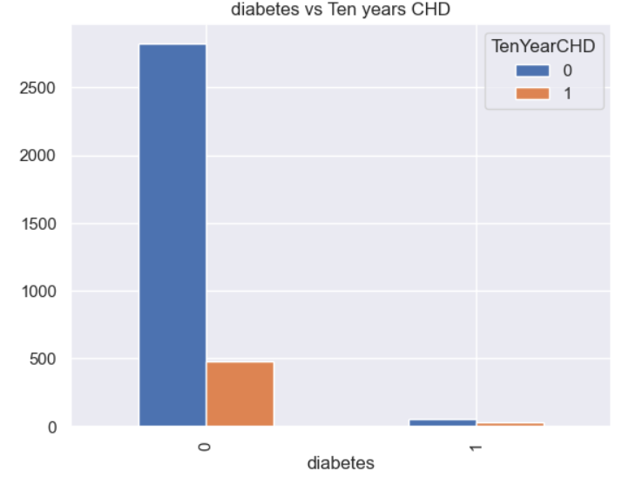
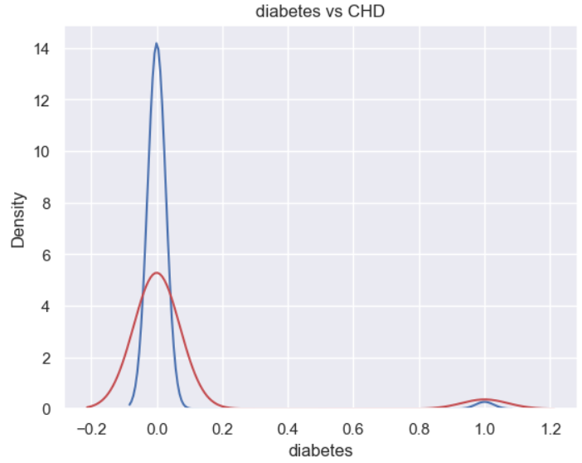
Insights –
Insight here is people with no prior diabetes record have 83% chances of not been at risk of CHD , where as 14% developed risk of CHD.

Slide 15
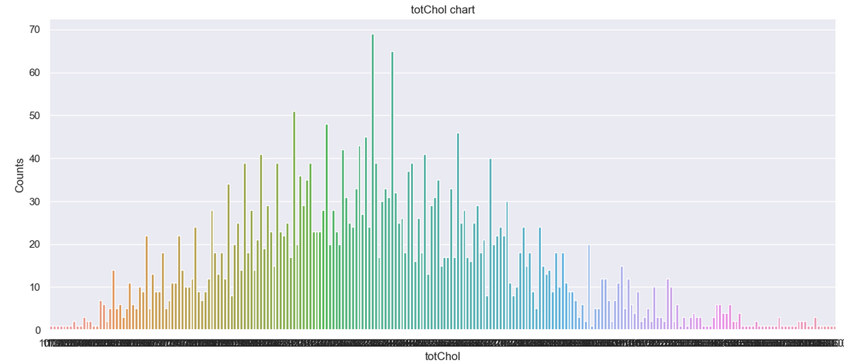
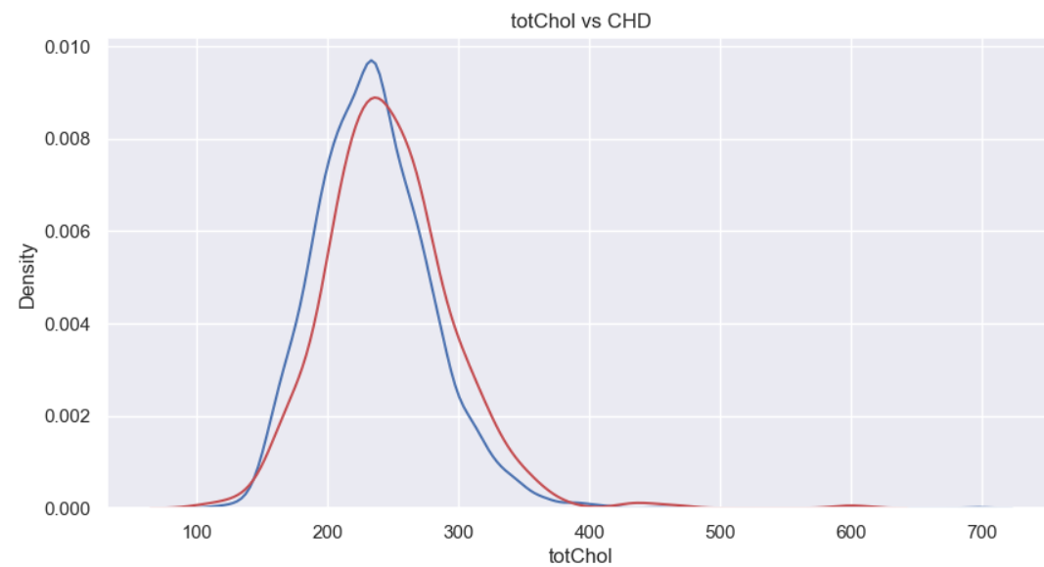
Insights –
Our finding is when attribute 'totChol' is greater than 234 or (50 percentile) , we get around 60% of potential CHD risk individuals.
Means - out of all 511 records of CHD = 1 , we see 60% of them when 'totChol' > 234.

Slide 16
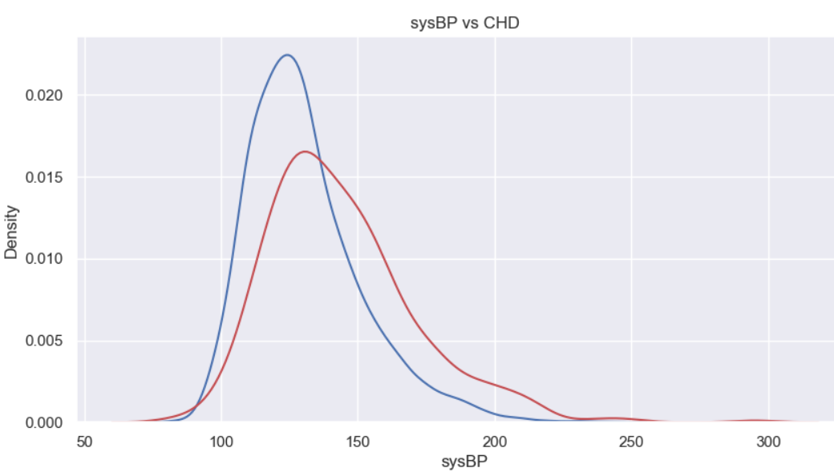
Insights –
Our finding is when attribute 'sysBP' is greater than 128 or (50 percentile) , we get around 70% of potential CHD risk individuals.
Means - out of all 511 records of CHD = 1 , we see 70% of them when 'sysBP' > 128(50%)

Slide 17
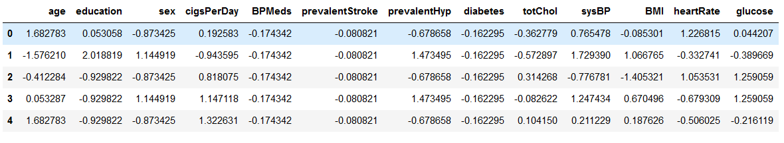
More EDA –
We used label encoder to encode values of attributes – ‘sex’ and ‘is_smoking’ as they were – yes/no and converted them into 0 and 1.
We implemented feature scaling by using standardscaler to scale our dataset.
We checked for skewness andimplemented Skewness Treatment By yeojohnson method.
Skewed column - ‘cigsperday’.

Slide 18
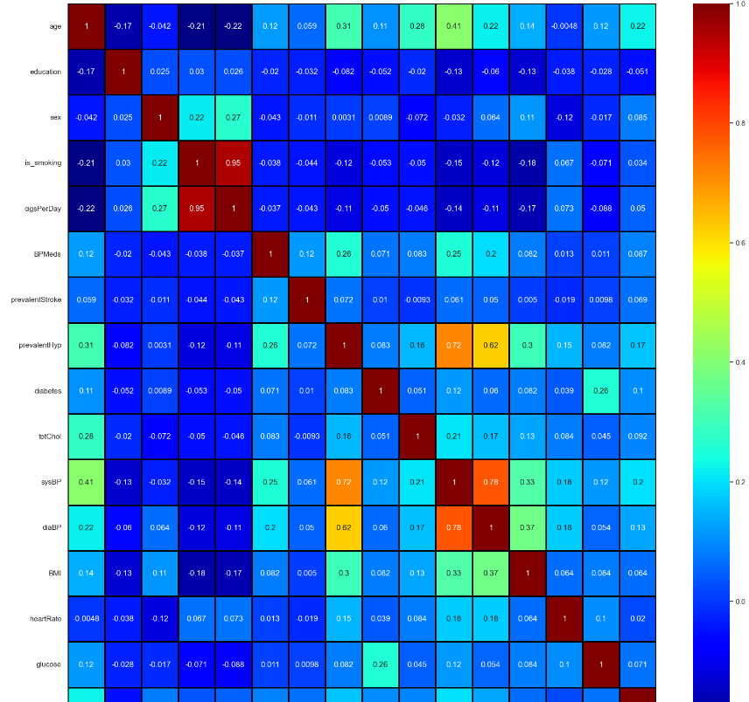
Co-relation Matrix –
Findings -
1) Attributes ‘is_smoking’ and ‘cigsPerDay’ have a correlation of 0.9480
2) Attributes ‘sysBP’ and ‘diaBP’ have a correlation of 0.779
3) All attributes have moderate to low correlation with target column.

Slide 19
Model Building -
Model 1 - XGboost Classifier
Train & test accuracy – 0.98 & 0.89.
precision recall f1-score
0 0.87 0.92 0.89
1 0.91 0.86 0.89
AUC-ROC score – 0.888
Model 2 - RandomForest Classifier
Train & test accuracy – 0.96 & 0.87.
precision recall f1-score
0 0.90 0.87 0.88
1 0.87 0.90 0.89
AUC-ROC score – 0.87

Slide 20
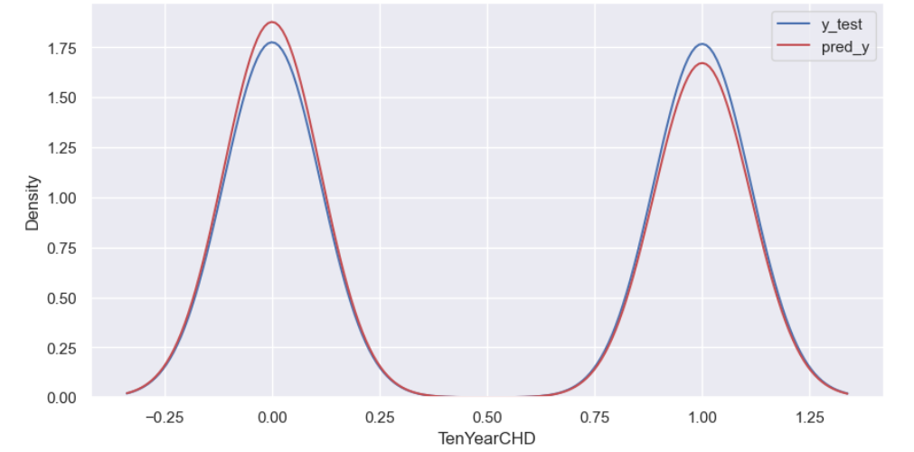
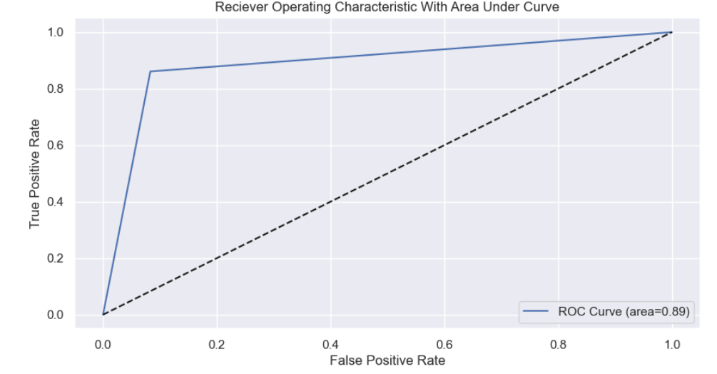
Model fitting & AUC – ROC curve -

Slide 21
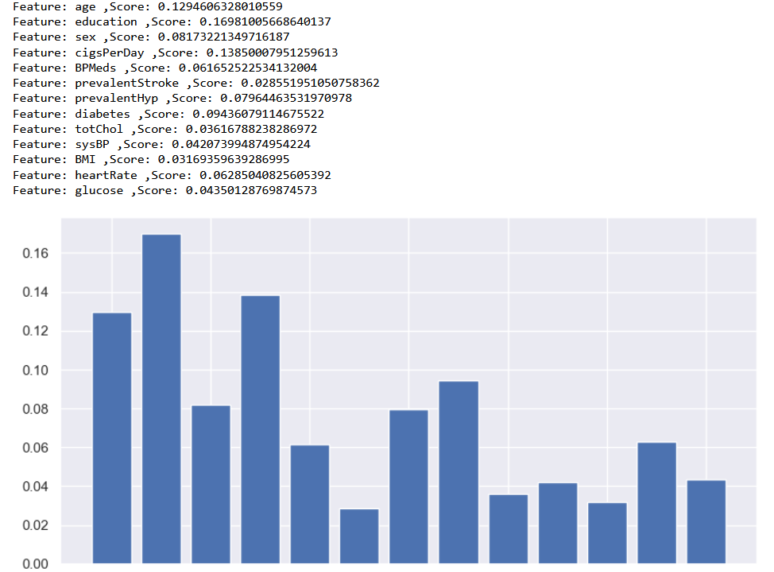
Important Features –
Random Forest calculates feature importance using a metric called Gini Importance. This metric measures the total reduction in impurity (Gini impurity) achieved by splitting data on a particular feature. The higher the reduction in impurity, the more important the feature is considered.
XGBoost, on the other hand, computes feature importance using a metric called Gain Importance. It calculates the average gain (improvement in accuracy) of splits that involve a particular feature. Features with higher average gain are considered more important.
important features -
1) age ,Score: 0.1294
2) education ,Score: 0.1698
3) cigsPerDay ,Score: 0.1385
4) diabetes ,Score: 0.09436

Slide 22
I believe that data tells us more than just numbers, it helps us understand our users and their desires.
Thank you

